Slide 1
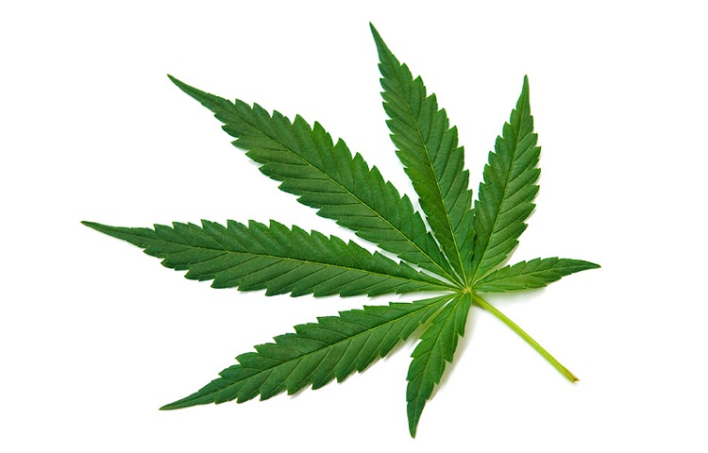
Predicting Cannabis Users
Orlando Carpio, Yuan Chai and
Ruth Mary Jimenez
Rutgers Datascience Bootcamp

Slide 2
Project Goals:
Our Team’s goal was to find the best machine learning model to predict cannabis users when looking at features such personality traits and demographics.
Leverage machine learning methods to analyze relationships between each criterion and its likelihood of leading to drug usage.
Find and apply the machine learning model with the most accurate prediction the data set and predict the potential risk of cannabis use.

Slide 3
Defining the Workflow
Gathering the Data
Data Processing
Data Visualization
Researching the best model that works with out data
Training and Testing the Model
Evaluating the Model

Slide 4
Data Gathering
Find the Training/Testing Data Set
We found a .data file, "Drug consumption (quantified) Data Set" from the UCI Machine Learning Repository, ready for Machine Learning analysis. Weblink
The data contains 1885 number of instances. It also contains 18 classification problems. Each of independent drug label variables contains seven classes: "Never Used", "Used over a Decade Ago", "Used in Last Decade", "Used in Last Year", "Used in Last Month", "Used in Last Week", and "Used in Last Day".

Slide 5
Data Gathering
Validation Data Set
This second data set was obtained from SAMHDA Substance Abuse and Mental Health Services Administration. Weblink
The series is from the National Survey on Drug Use and Health, 2017 (NSDUH-2017-DS0001).
The National Survey on Drug Use and Health (NSDUH) series, is a major source of statistical information on the use of illicit drugs, alcohol, and tobacco and on mental health issues among members of the U.S.

Slide 6
Data Set Information:
The data set contains records for 1885 respondents. For each respondent 12 attributes are known: Personality measurements which include NEO-FFI-R (neuroticism, extraversion, openness to experience, agreeableness, and conscientiousness), BIS-11 (impulsivity), and ImpSS (sensation seeking), level of education, age, gender, country of residence and ethnicity. All input attributes are originally categorical and are quantified. After quantification values of all input features can be considered as real-valued.
In addition, participants were questioned concerning their use of 18 legal and illegal drugs (alcohol, amphetamines, amyl nitrite, benzodiazepine, cannabis, chocolate, cocaine, caffeine, crack, ecstasy, heroin, ketamine, legal highs, LSD, methadone, mushrooms, nicotine and volatile substance abuse and one fictitious drug (Semeron) which was introduced to identify over-claimers. For each drug they have to select one of the answers: never used the drug, used it over a decade ago, or in the last decade, year, month, week, or day. Database contains 18 classification problems. Each of independent label variables contains seven classes: "Never Used", "Used over a Decade Ago", "Used in Last Decade", "Used in Last Year", "Used in Last Month", "Used in Last Week", and "Used in Last Day".
Sources: Original Owners of the data set: Elaine Fehrman, Vincent Egan, Evgeny M. Mirkes, and Evgeny M. Mirkes. Weblink

Slide 7
Data Processing
ETL
Manipulate the quantified data. The data set we chose was already grouped into bins. One of the reasons for the binning is to force an even distribution of the values.
Assign headers to the data. The headers were unknown; we referenced the UCI webpage where explanations for each feature were found, and assigned the column names and their order, accordingly.

Slide 8
Data Processing
ETL
Extract the columns (features) that will be used with our machine learning model.
Save a CSV copy of the filtered data to use with Tableau.
Perform the same tasks to the Validation data set.

Slide 9
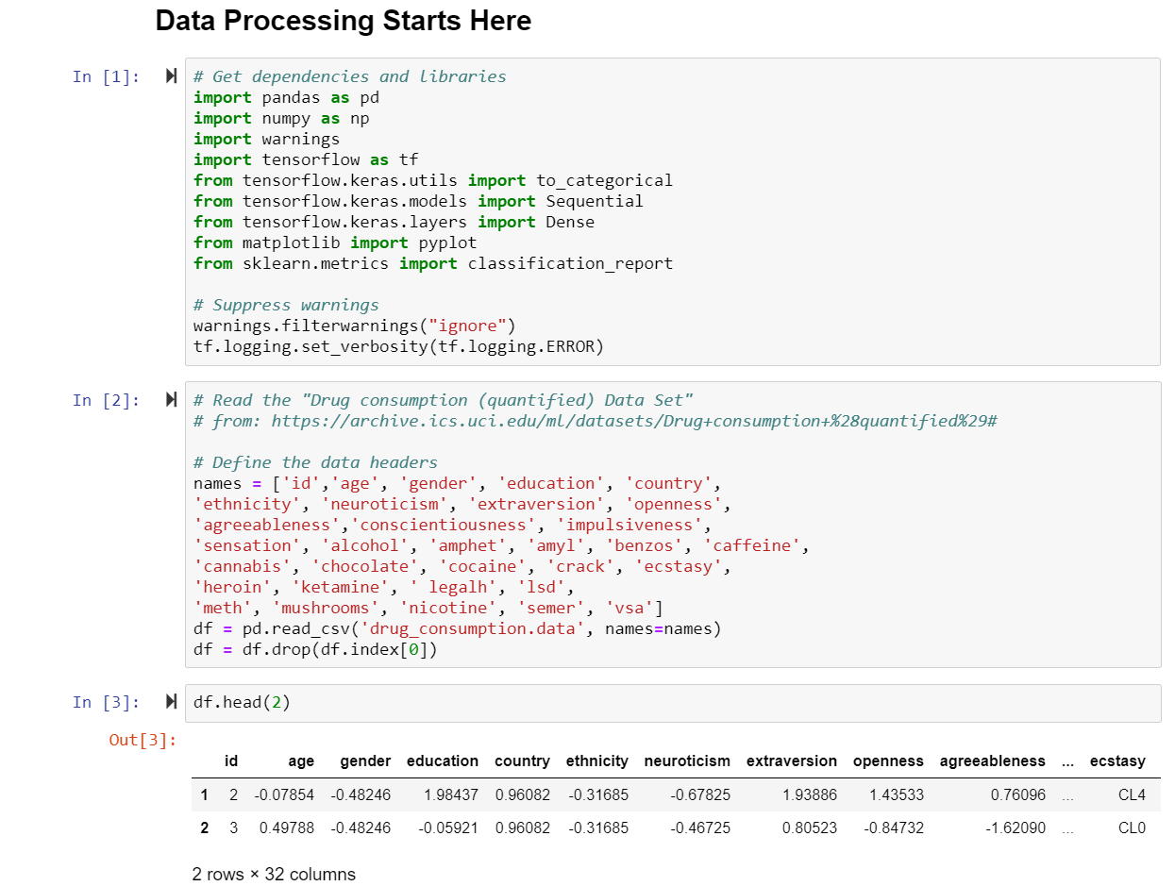
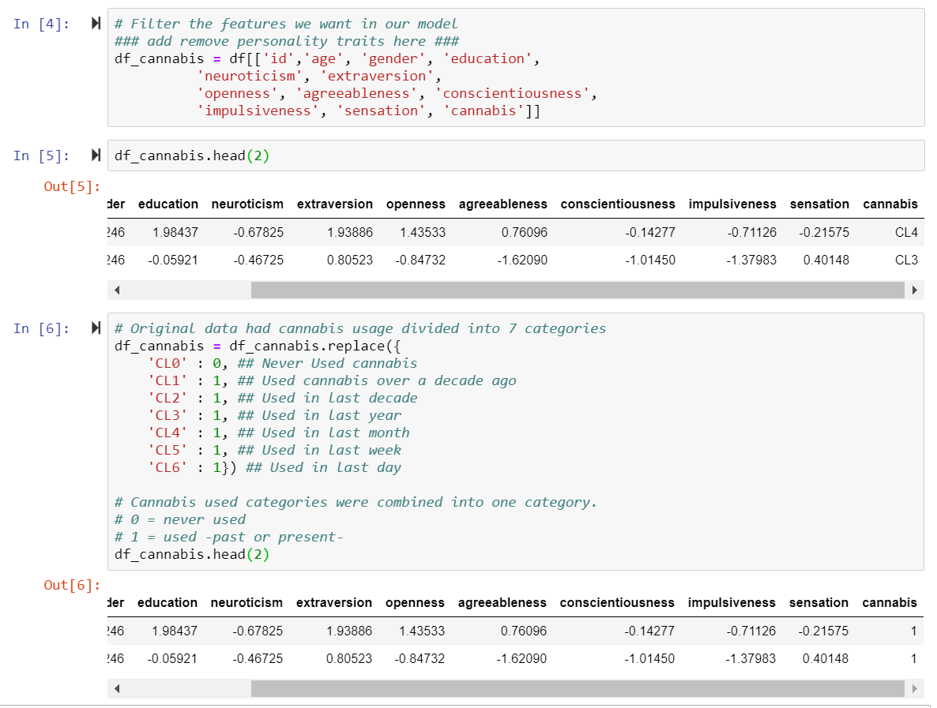
ETL

Slide 10
Data Processing
Python Libraries
Pandas
Numpy
Warnings
Tensorflow
Sci-kit Learn
Matplotlib

Slide 11
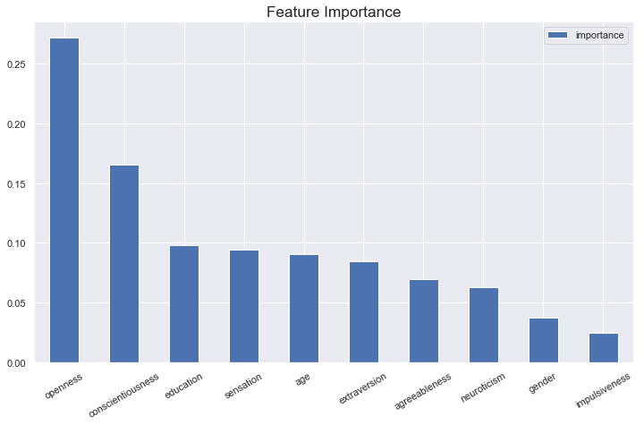
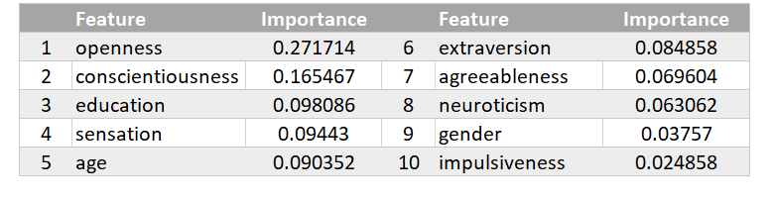
Data Visualization
Pandas & Matplolib
Use Gradient Boosting Classifier to see which features are important

Slide 12
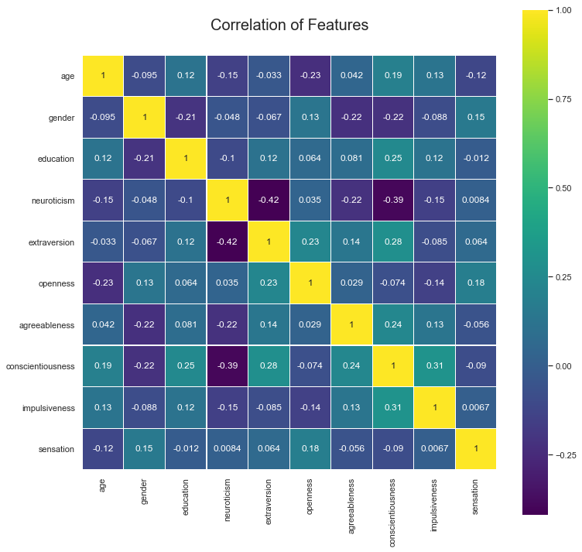
Data Visualization
Pandas & Matplolib
After normalizing the data and selecting the relevant features, we proceeded to get the correlation between the selected features.
We created a correlation matrix or heatmap.

Slide 13
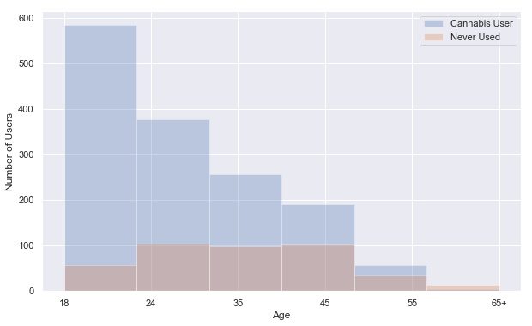
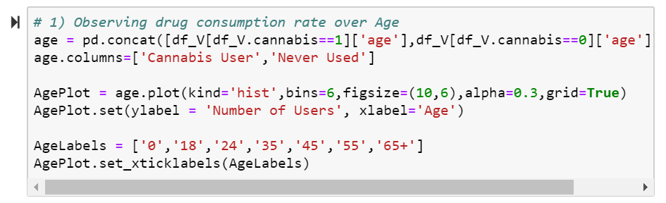
Data Visualization
Pandas & Matplolib
Drug consumption per feature
Cannabis Users by Age
We used the Seaborn library with this plot.
The data shows young adults are the biggest group of cannabis users

Slide 14
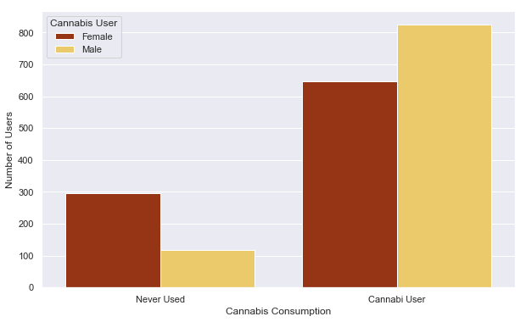
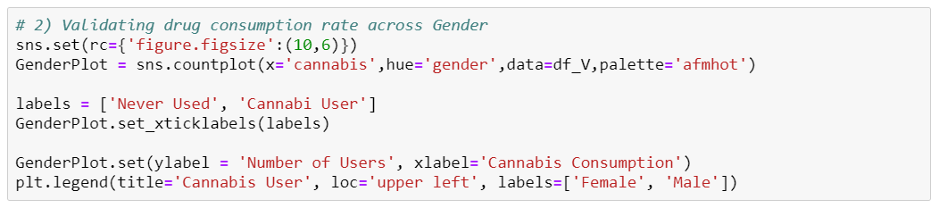
Data Visualization
Pandas & Matplolib
Drug consumption per feature
Cannabis Users by Gender
Among the 2 genders, male users surpass female users.

Slide 15
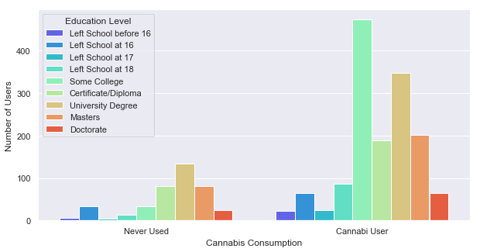
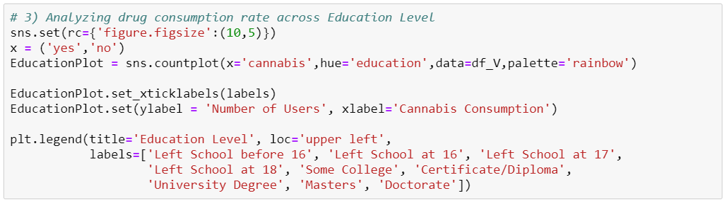
Data Visualization
Pandas & Matplolib
Analyzing drug consumption rate across Education Levels
Education or lack of education’s influence is minimal for cannabis use.

Slide 16
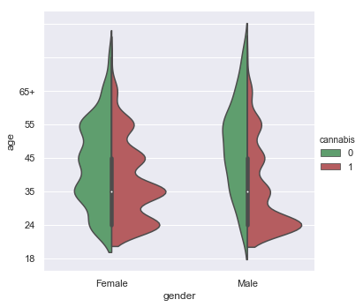
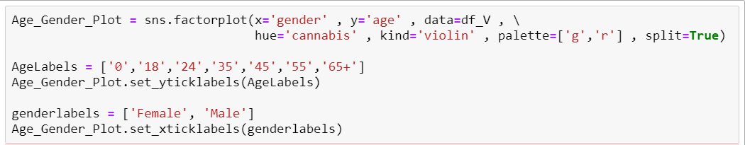
Data Visualization
Pandas & Matplolib
Drug consumption per feature
Cannabis Users by Gender and Age
We used a Seaborn Catplot to better represent the 3 features selected.

Slide 17
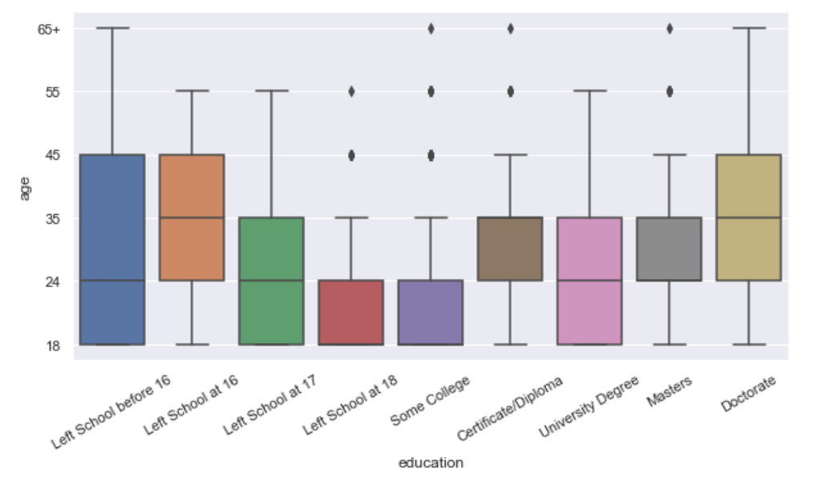
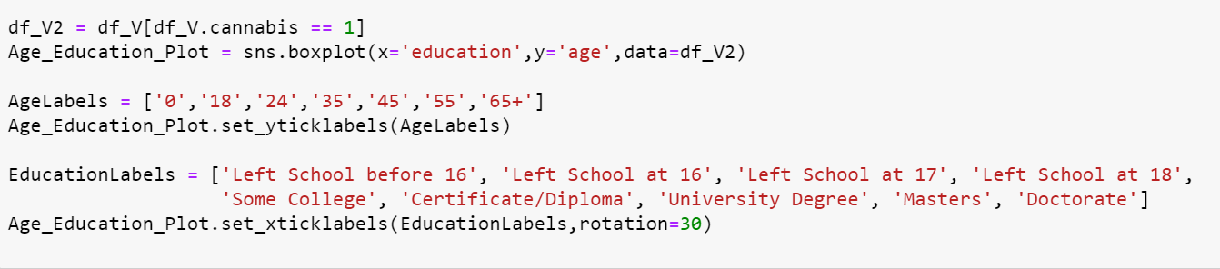
Data Visualization
Pandas & Matplolib
What if combine Age and Education Level together?
Focus only on the actual cannabis users.

Slide 18

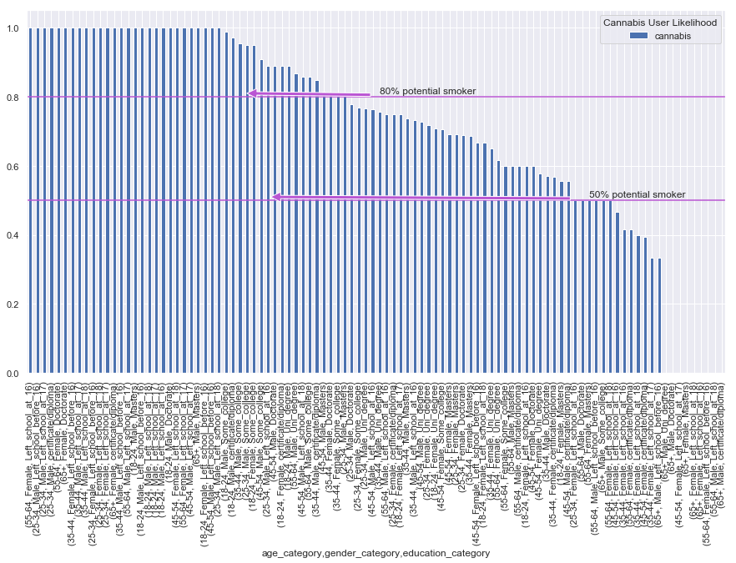
Data Visualization
Pandas & Matplolib
Bring all the basic demographic features (Age, Gender, Education) together and create a pivot table.
There is definitely a relationship among 'Age','Gender','Education’and 'Drug Consumer’
We combined them together and visualize it.

Slide 19
Modeling & Evaluation
Prediction:
The target prediction is to determine if the selected features influence the use of cannabis among our data respondents.
Given the nature of our features after several modifications; as well as the problems we encountered along the way, a simple logistic regression algorithm was found to be the most effective model for our target prediction.
Logistic regression models are easily understood, and commonly used for the classification of problems with two possible outcomes.

Slide 20
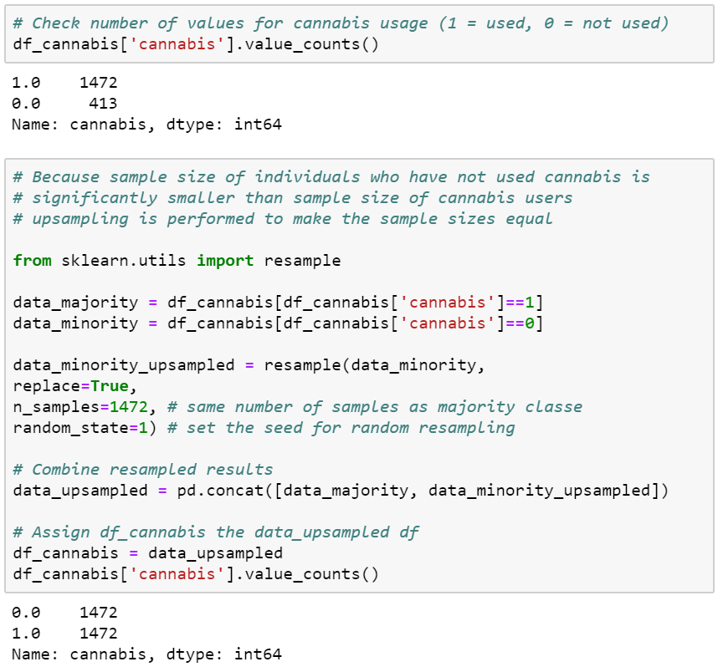
Modeling & Evaluation
Data Evaluation Process:
The original data set contained 1885 respondents.
1472 were considered users and 413 non-users.
Because the sample size of individuals who have not used cannabis is significantly smaller than sample size of cannabis users, upsampling is performed to make the sample sizes equal
We used a new library called resample.

Slide 21
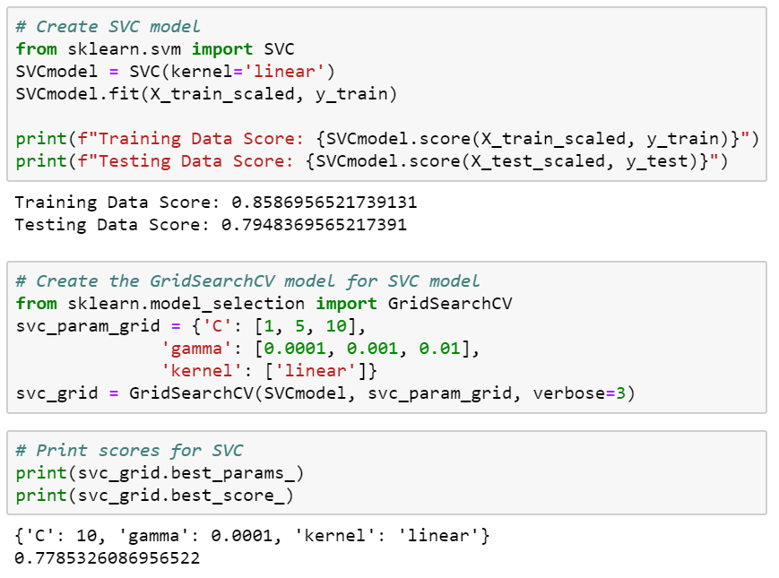
Modeling & Evaluation
Models Tested:
SVC Model

Slide 22
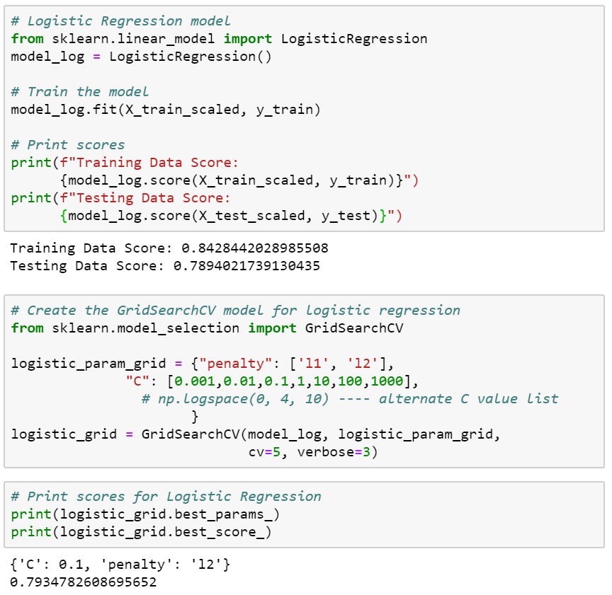
Modeling & Evaluation
Models Tested:
Logistic Regression Model
This model gave us the best result.

Slide 23
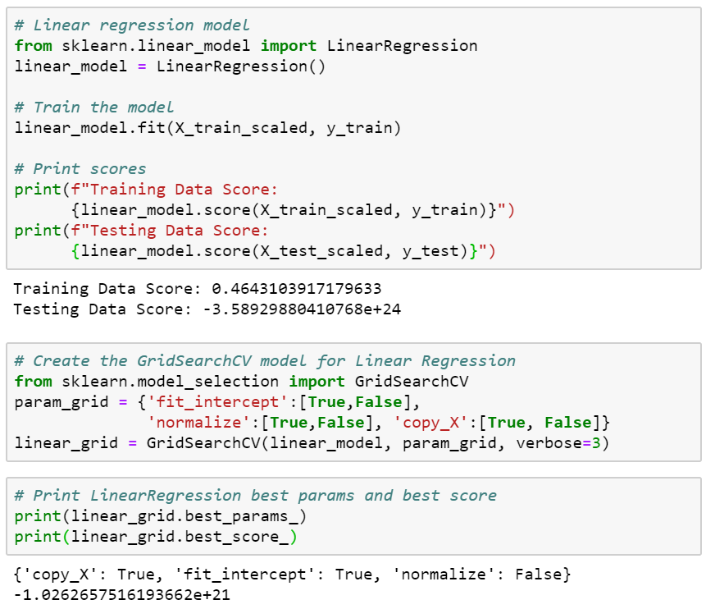
Modeling & Evaluation
Models Tested:
Linear Regression Model

Slide 24
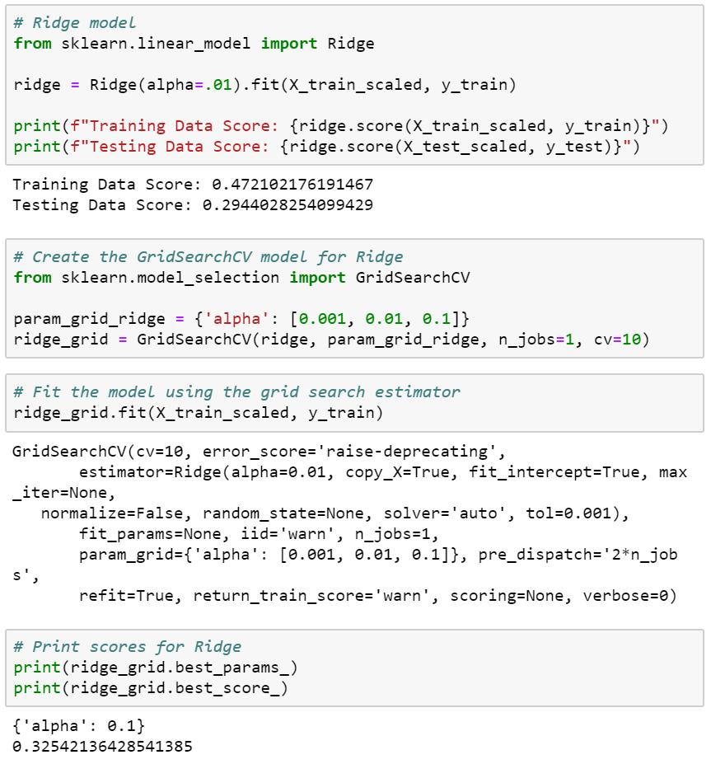
Modeling & Evaluation
Models Tested:
Ridge Model

Slide 25
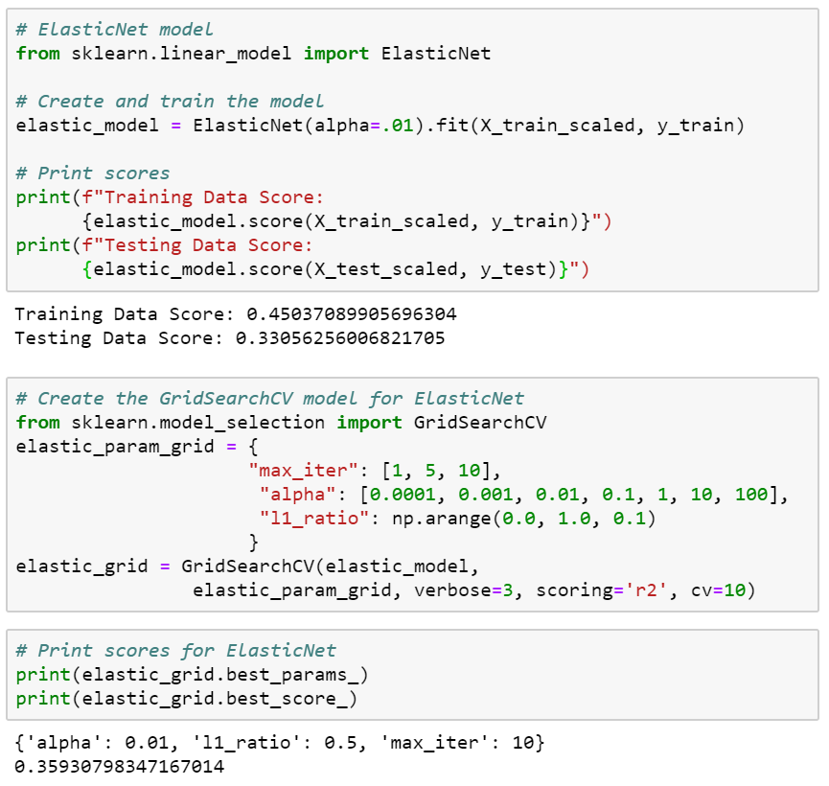
Modeling & Evaluation
Models Tested:
ElasticNet Model

Slide 26
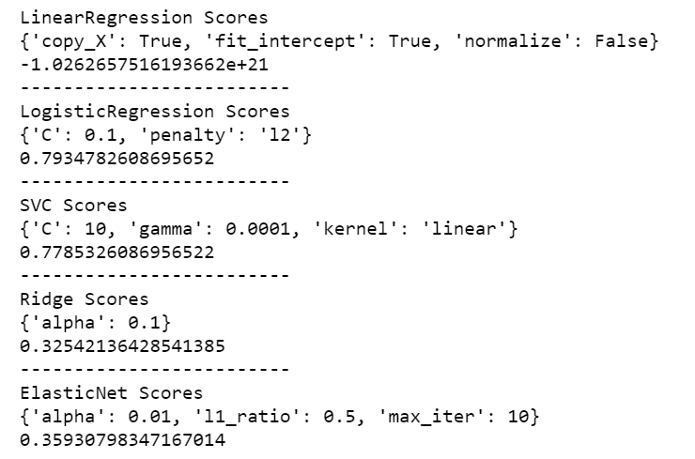
Modeling & Evaluation
Model Results Comparison
Linear Regression
Logistic Regression
SVC
Ridge
ElasticNet

Slide 27
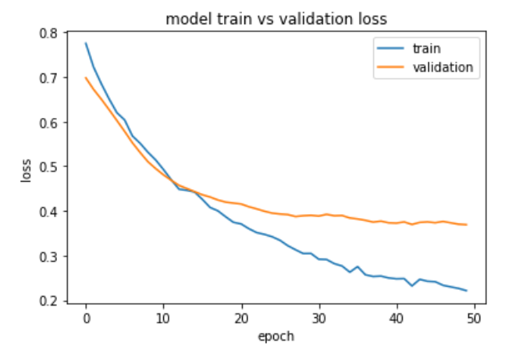
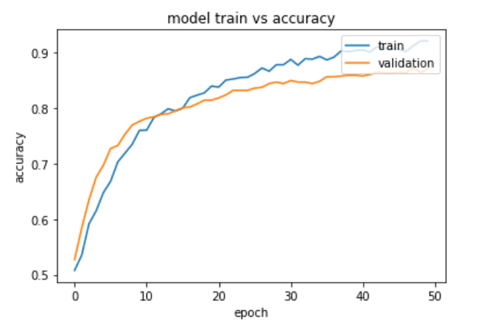
Modeling Results
Train Data vs Validation Data
Deep Neural Network Train
Loss: 0.3168505177549693
Accuracy: 0.9270833134651184
Deep Neural Network Test
Loss: 0.5623318915781768
Accuracy: 0.842391312122345

Slide 28
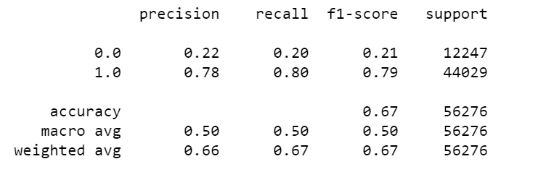
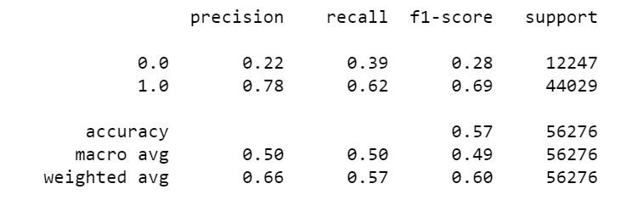
Modeling & Evaluation
Logistic Regression Model Results
Model Results Comparison
Logistic Regression
SVC
SVC Model Results

Slide 29
Conclusion
Prediction result:
We were able to make a decent logistic regression model for binary classification of cannabis users from the machine learning dataset. It appears to do a fair job identifying cannabis users correctly in the original dataset.
However, when applied to the validation test dataset, the model incorrectly labels a significant number of cannabis users as nonusers.
The model does not appear reliable for identifying cannabis users on an individual basis. The model could be useful for classifying populations as potential targets for public health outreach.

Slide 30
Challenges
Data Processing
We changed the data multiple types, too much time spent just doing that.
Finding validation data that would match the test/train data. Hours were spent researching it to little success, we had to randomize the personality traits to make it work.
Modeling & Evaluating
Due to all the changes to the data obtaining the models final scores took time.

Slide 31
Q & A ?

